Slide 1
Swords of Turing
Group 26

Slide 2
Overview
Swords of Turing is an online 2 player sword fighting game in which you are connected to many other players around the world.

Slide 3
How the game works – How to Win
The game works by having a 2 attacking moves and 2 blocking moves.
These moves are time sensitive, meaning when a move is used, there is a limited time that you can block the damage from it.
When a move is used by either player, the stamina bar will decrease by the stamina cost of that move.
Move | Stamina | Damage
Stab | 40 | 20
Slash | 80 | 40
Block | 0 | 0
Parry | 45 | 0

Slide 4
Moves
During testing of our game, we found of that the current system of moves that we used was far to simple.
This meant that we decided to use directional moves as well in order to diversify the game from other sword fighting games.
This meant that there is now 9 different moves that a player could do, and 108 different combinations of moves.

Slide 5
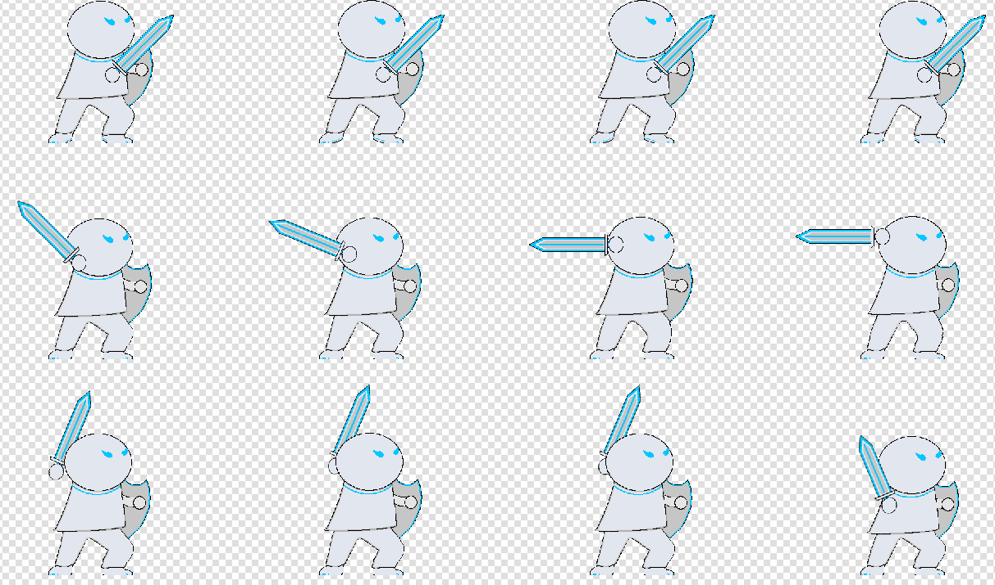
Artwork
We wanted to have a fun and fresh looking game, that used sprites and art that isn’t copyright free on the internet, meaning that we will have a game that features sprites that we made ourselves.
Here is an example sprite sheet that we made that features each individual frame used in the animation.

Slide 6
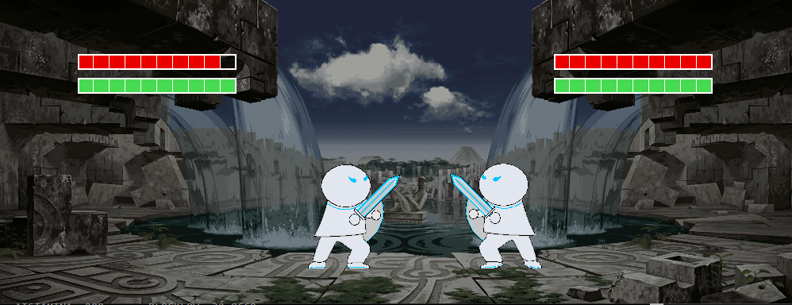
How to beat your opponent and win

Slide 7
Hands on Playing
Play the game and ask the questionnaire

Slide 8
AI

Slide 9
Game

Slide 10
Screenshots

Slide 11
Problems We Encountered

